Slide 1

Compiler design

Slide 2


Prof – Nandini Mukherjee
Dept – Computer Science & Engineering
Jadavpur University
E-mail id – nmukherjee.cse@gmail.com

Slide 3
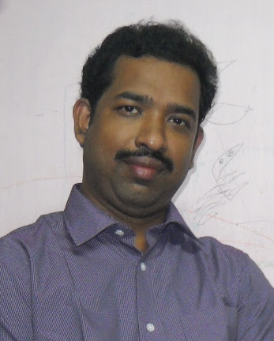
Prof – Kamal Sarkar
Dept – Computer Science & Engineering
Jadavpur University
E-mail id – jukamal2015@gmail.com

Slide 4


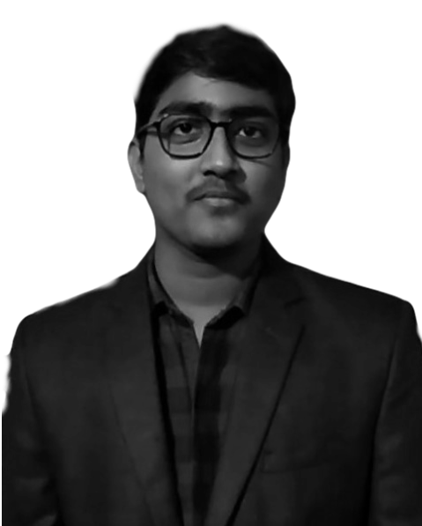

ARNAB LAYEK
ROLL NO. – 001710501075
DIBYENDU MUKHERJEE
ROLL NO. – 001710501077
SHUBHADEEP MONDAL
ROLL NO. - 301810501001
BIDISA PAL
ROLL NO. - 301810501002

Slide 5
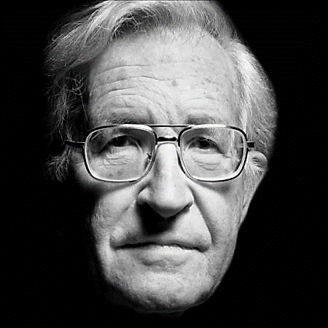
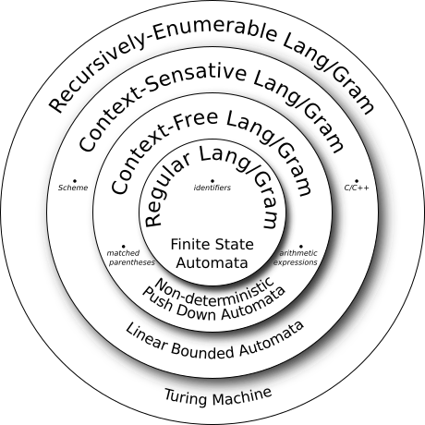
Noam Chomsky
Hierarchy of
Formal Languages

Slide 6
CONTEXT FREE GRAMMAR
<program> -> <rtype> main ( ) { <dec_list> <stmt_list> }
<rtype> -> int | void
<dec_list> -> <con_type> <dtype> <id_list>
<con_type> -> const | eps
<dtype> -> int | float | char | string | void
<id_list> -> id <id_list'>
<id_list'> -> , id <id_list'> | eps
<stmt_list> -> <stmt> <stmt_list'>
<stmt_list'> -> <stmt> <stmt_list'> | eps
<stmt> -> <assign> | <if_stmt> | <for_stmt> | <while_stmt>
<assign> -> id = <exp>
<exp> -> <term exp'>
<exp'> -> + <term exp'> | - <term exp'> | eps
<term> -> <factor> <term'>
<term'> -> * <factor> <term'> | / <factor> <term'> | eps
<factor> -> id | integer | ( <exp> )
<for_stmt> -> for ( id = <exp> ; <cndtn> ; id = <exp> ) { <stmt_list> }
<cndtn> -> <exp> <relop> <exp>
<relop> -> < | >
A Context-free grammar is notably used for describing grammar.
It is more powerful than finite Automata but still cannot define all possible languages.
It is useful for nested structures.

Slide 7
Source C Code
Boolean returns
Stream of characters
DFA
Lexical Analyzer
Lex analyze DFA()
Stream of Tokens
Tokens are a part of a given language
LEXEME TOKEN
FIG – ARCHITECTURE OF LEXICAL ANALYZER

Slide 8
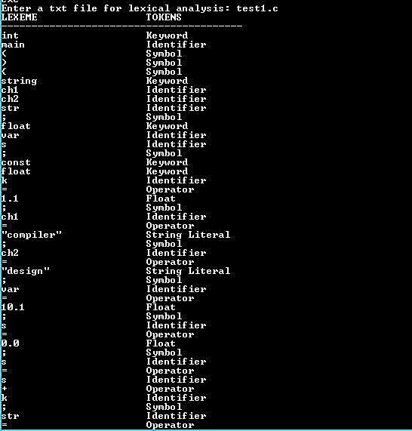
FIG – OUTPUT OF LEXICAL ANALYZER

Slide 9
CFG
Final Production
LEFT
RECURSIVE
TOP DOWN PARSER
FIRST
FOLLOW
Original Production
Parse Table Construction
FIG - ARCHITECTURE OF TOP DOWN PARSER

Slide 10

Thank you

